Slide 1
Rainforest, Biodiversity, Water Cycle

Slide 2
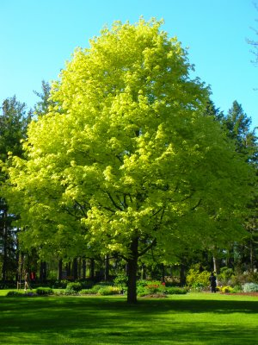
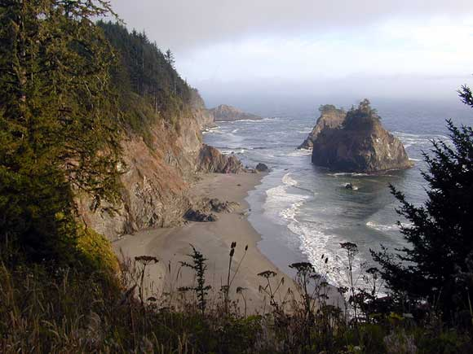
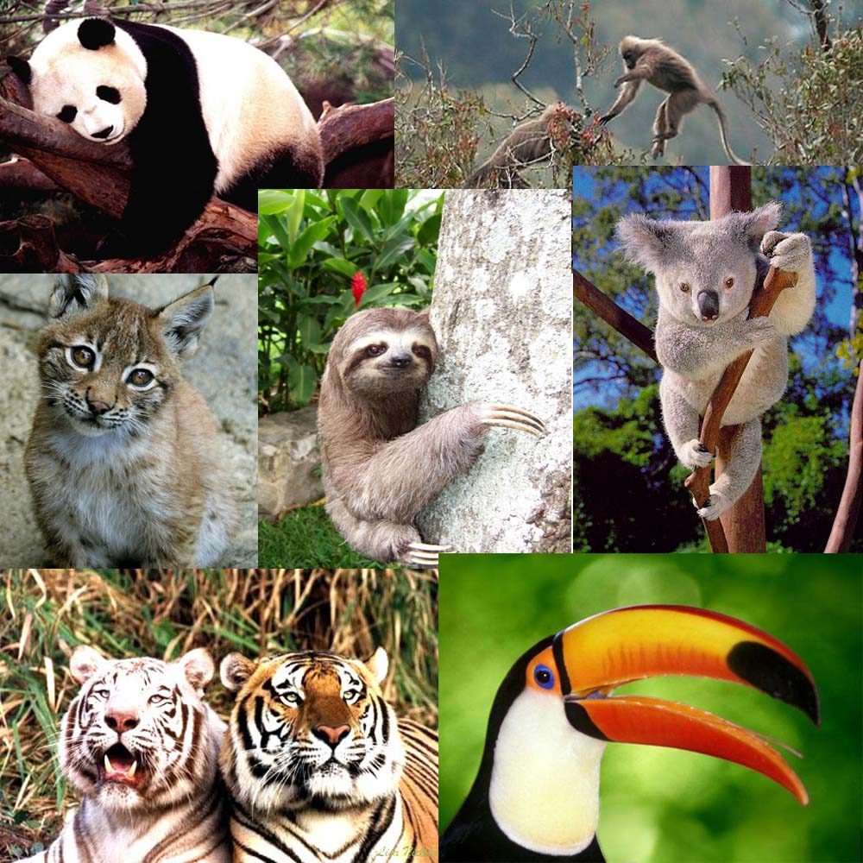
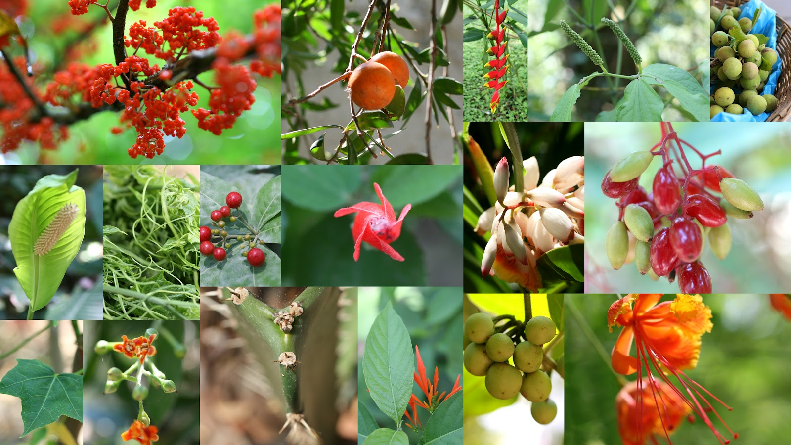
Biome: Environment characterized by climate and dominant flora (plants) and fauna (animals).

Slide 3
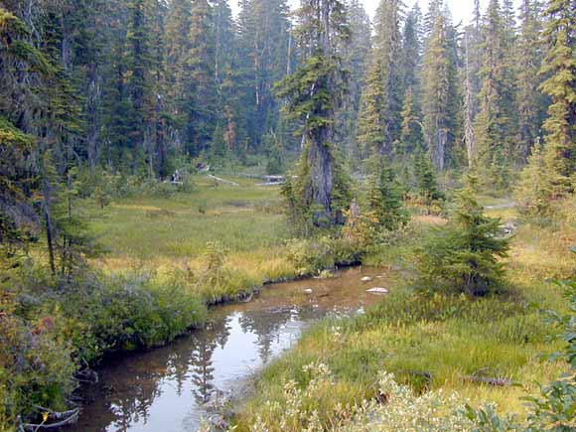
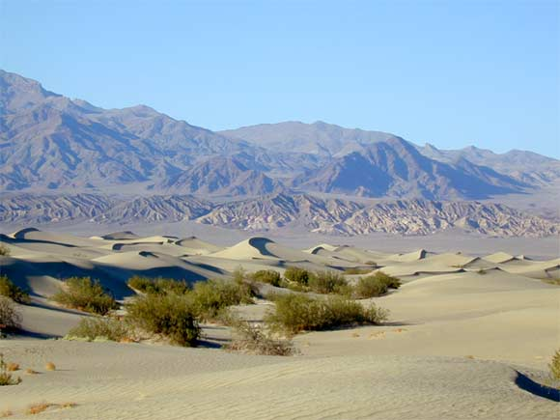
Land Biomes
Tropical rain forest
Tundra
Taiga
Deciduous forest
Grassland
Desert

Slide 4
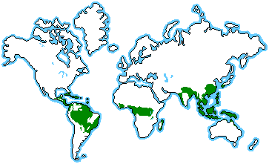
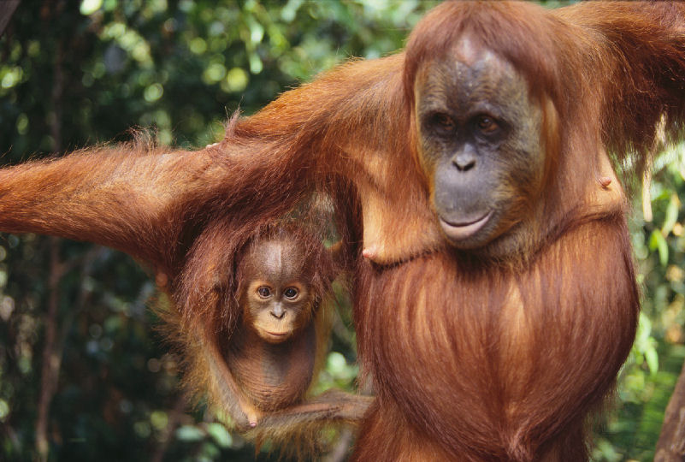
Tropical Rain Forests
Temperature is always warm, rain falls all year (50-260 inches per year).
Usually found near the equator (South/Central America, Africa)
Biome with the greatest biodiversity

Slide 5
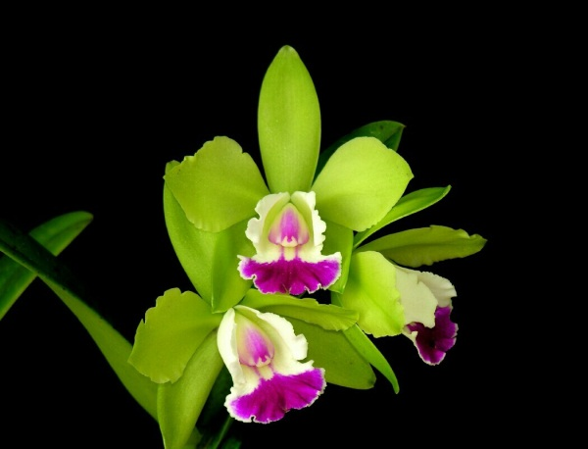
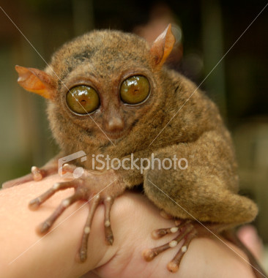
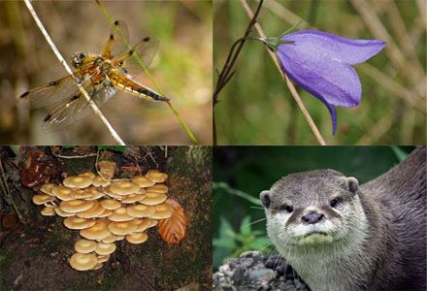
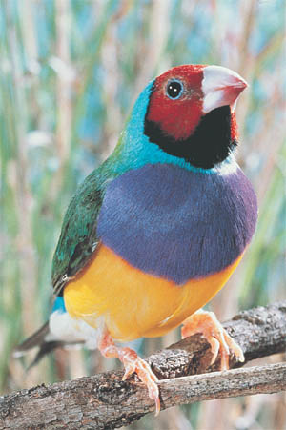
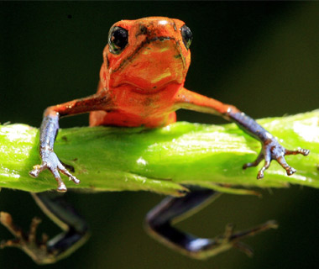
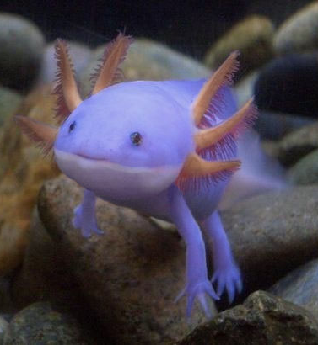
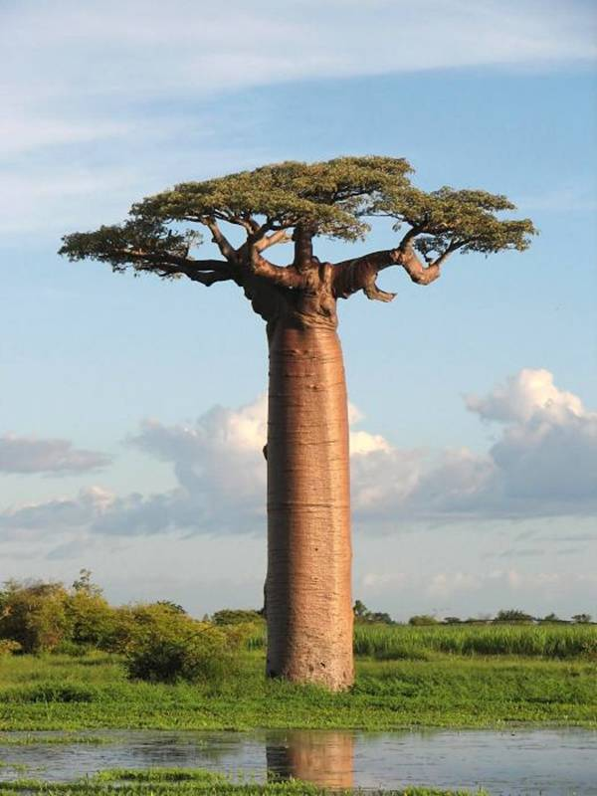
Biodiversity: the variety of life in an area.

Slide 6
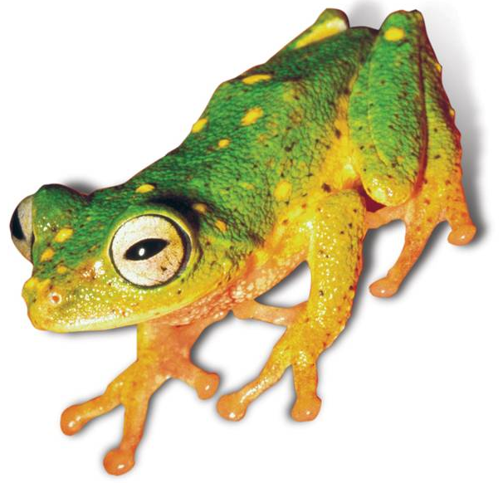
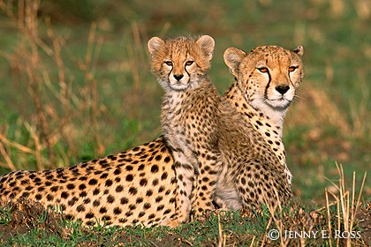
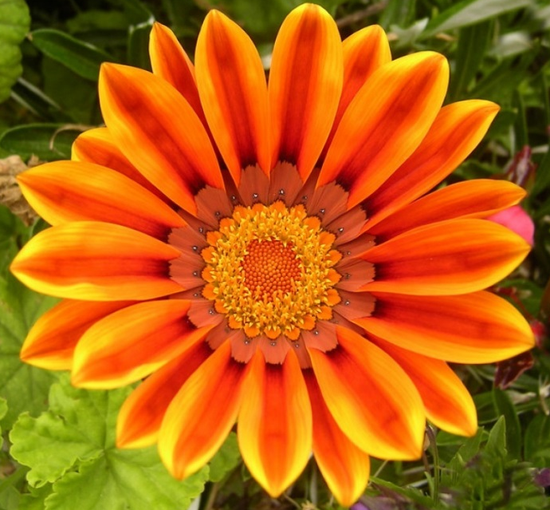
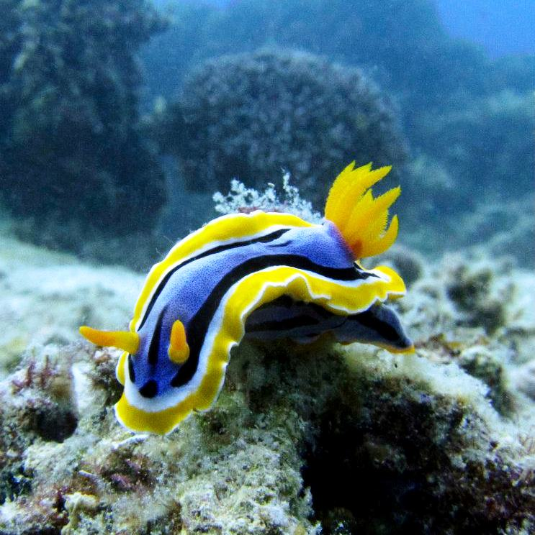
The loss of biodiversity would mean:
loss of medical and technological advances
extinction of species
loss of ecosystem stability

Slide 7
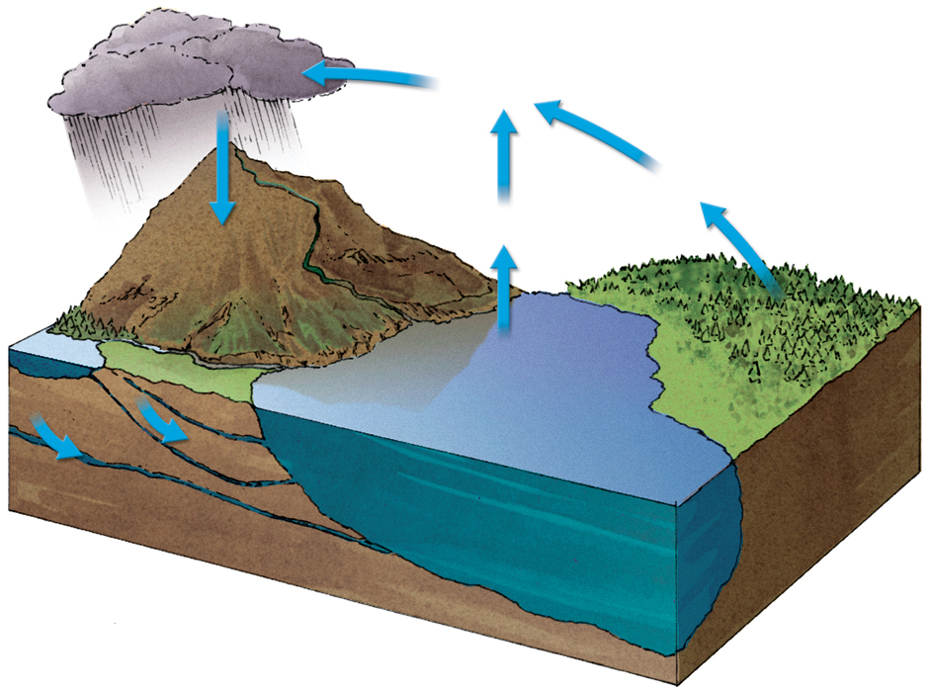
Hydrologic/Water Cycle
The circular pathway of water on Earth
precipitation
condensation
transpiration
evaporation
surface
runoff
lake
water storage
in ocean
groundwater
seepage

Slide 8
Parts of the water cycle
Evaporation: water changes from liquid to vapor
Transpiration: water evaporates from plants
Condensation: water changes from vapor to liquid.
Ex: clouds, fog
Precipitation: water is released from clouds in the form of rain, freezing rain, sleet, snow, or hail

Slide 9
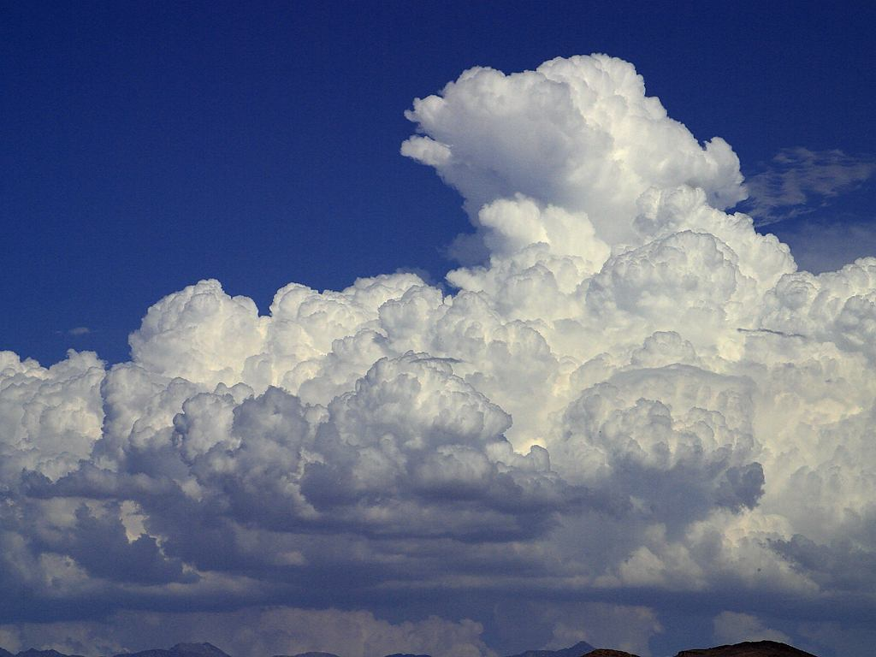
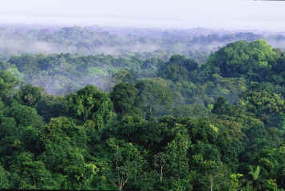
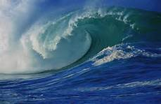
Condensation: Water changes from vapor to liquid, forms clouds
Water Cycle
Precipitation: Water is released from clouds and falls to earth
Transpiration: Water from plants vaporizes
Evaporation: Water changes from liquid to vapor

Slide 10
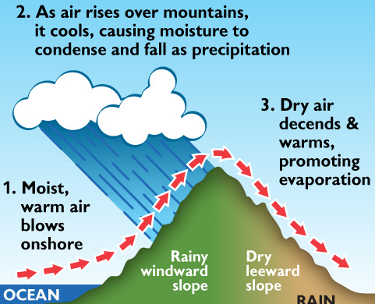
Rain Shadow Effect
Moist air reaches a mountain range.
Increase in elevation causes condensation which leads to precipitation.
Air is dry by the time it reaches the other side of the mountain.
Results in deserts

Slide 11
